Slide 1

How To Speak Tech and What To Expect From a Tech Career
Aviwe Qata
22 February 2023

Slide 2





Aviwe

Slide 3



About me
Notes:
Today we are going to talk about various roles in tech while we learn some cool new terms.

Slide 4
Table of contents
01.
02.
What Is Software Development?
Software Development Life Cycle (SDLC)

Slide 5
Table of contents
04.
05.
Software Methodologies
The Scrum Framework

Slide 6
Careers!?

Slide 7
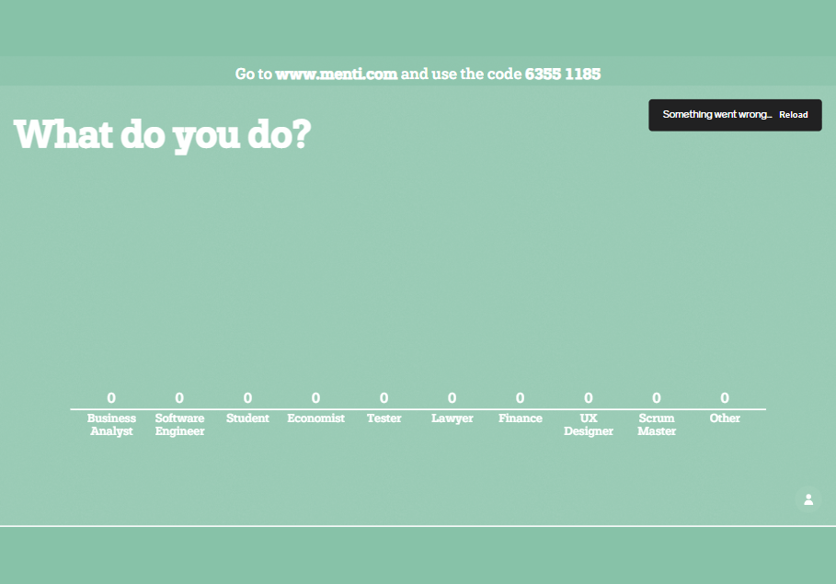

Slide 8

01.
What Is Software Development?

Slide 9
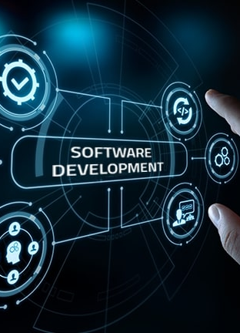
What Is Software Development?
What Is Software Development?
Software development – computer science activities dedicated to creating, designing, deploying and supporting software.
Software – set of instructions or programs that tell a computer what to do.

Slide 10
Here are three basic differentiators
What Is Software Development?
System Software
Programming Software
Application Software
Core functions including operiting systems, disk management, utilities and hardware management.
Give programers tools to create code like, text editors, compilers and linkers debbuggers.
Helps users perform tasks, this includes data management software and media players.
Notes:
System software to provide core functions such as operating systems, disk management, utilities, hardware management and other operational necessities.
Programming software to give programmers tools such as text editors, compilers, linkers, debuggers and other tools to create code.
Application software (applications or apps) to help users perform tasks. Office productivity suites, data management software, media players and security programs are examples. Applications also refers to web and mobile applications like those used to shop on Amazon.com, socialize with Facebook or post pictures to Instagram.

Slide 11

The different roles
What Is Software Development?
Programers, or coders
Write source code to program computers for specific tasks
Software engineers
Apply engineering principals to build software and systems to solve problems
Software Developers
Implements software development through a coding language and employs testing & maintenance of software
Notes:
These roles interact and overlap, and the dynamics between them vary greatly across development departments and communities.
Programmers, or coders, write source code to program computers for specific tasks like merging databases, processing online orders, conducting searches or displaying text and graphics.
Programmers typically interpret instructions from software developers and engineers.
Software engineers apply engineering principles to build software and systems to solve problems.
They use modeling language and other tools to devise solutions that can often be applied to problems in a general way, as opposed to merely solving for a specific instance or client.
Software engineering solutions adhere to the scientific method and must work in the real world, as with bridges or elevators.
Their responsibility has grown as products have become increasingly more intelligent with the addition of microprocessors, sensors and software.
Software developers have a less formal role than engineers and can be closely involved with specific project areas — including writing code. At the same time, they drive the overall software development lifecycle — including working across functional teams to transform requirements into features, managing development teams and processes, and conducting software testing and maintenance

Slide 12

Software Development Life Cycle (SDLC)

Slide 13
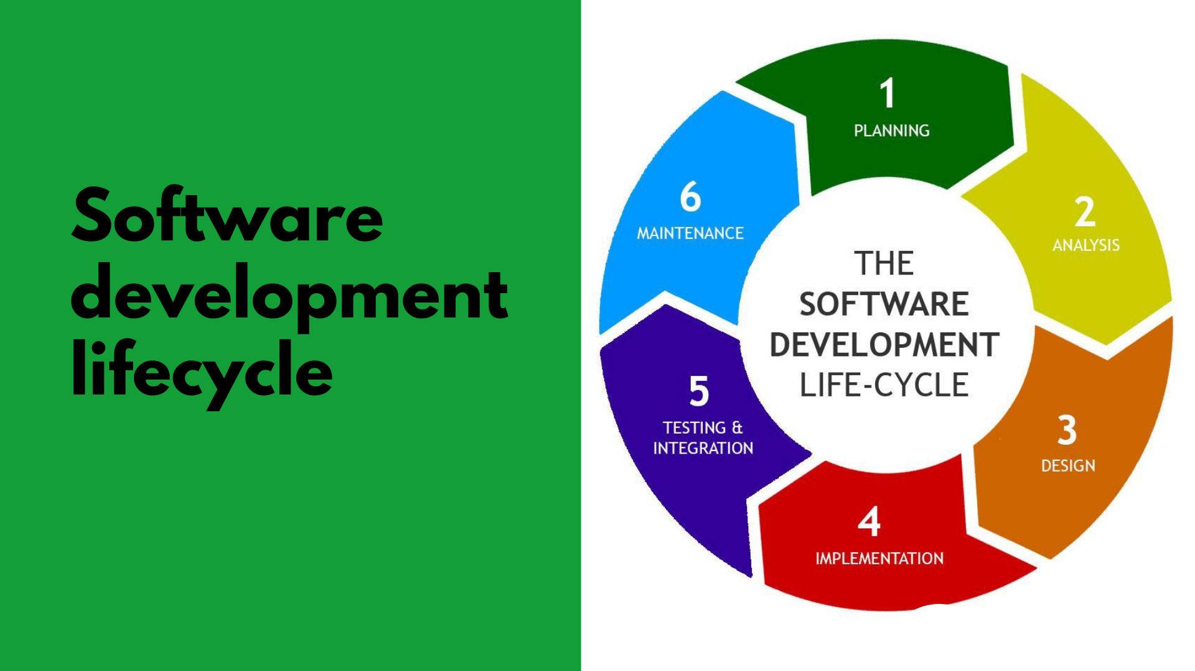
SDLC
Notes:
What is SDLC - Involves distinctive phases to initiate software production based on client requirements.

Slide 14
Scenario!
SDLC
Notes:
Friendship site for Bob

Slide 15

Planning Stage
SDLC
Define the problem and scope of any existing systems
The purpose of the application
Cost estimation
Timelines
Notes:
What are the sort of initial questions are we going to ask Bob at this planning stage?

Slide 16

Analysis Stage
SDLC
Eliciting all the specific details required for the new system
The details about the end-user of the product
Calibrating security protocols and performing risk analysis
Documenting requirements
Notes:
How will we get the information we need about the friendship site and what could we use to document these requirements?

Slide 17
Design Stage
SDLC
Devise the system following analyst documentation
Check feasibility with requirements
Document details in the DDS (Design Document Specification)
Share document for review with analyst and stakeholders
Notes:
When we are designing the application what are some of the things we want users to feel when using the app?

Slide 18

Development Stage
SDLC
The actual development starts, and the product is built
Start writing code using chosen programming language(s)
One of the most important phases as it encapsulates the implementation of the software product
Development tools used like compilers and debuggers to implement the code
Notes:
What could cause a lag in the development of this site?

Slide 19
Testing & Integration Stage
SDLC
Software is deployed in multiple test environments
Check functioning of all the attributes in the software
Detect any defects
Continue testing until system is stable
Notes:
What do you think happens when we find problems with the system at this testing stage?

Slide 20
Testing & Integration Stage
SDLC
Ready for deployment and consumer use
Development team will setup installation link for the users

Slide 21
Maintenance Stage
SDLC
Debugging of the application is done on a regular basis
Regular updates with enhanced features
Notes:
What might be new features that we would want to add to Bob’s Friendship site?

Slide 22
03.
Software Methodologies
Notes:
There are software methodologies used to implemented the SDLC
We will be discussing in detail two of these methodologies and them briefly look at four more

Slide 23
Waterfall
Software Methodologies
Requirements
Concept or idea of what the customer wants
Design
Logical design and physical design
Implementation
Building the design into actual software
Verification
Testing software against the requirements
Deployment and Maintenance
Release of the new software and ongoing deployment/maitnance
Notes:
Finishes one phase before another beginnings
Waterfall can be good when you have all the requirements and chances of them changing are slim
E.G Logging in functionality!

Slide 24
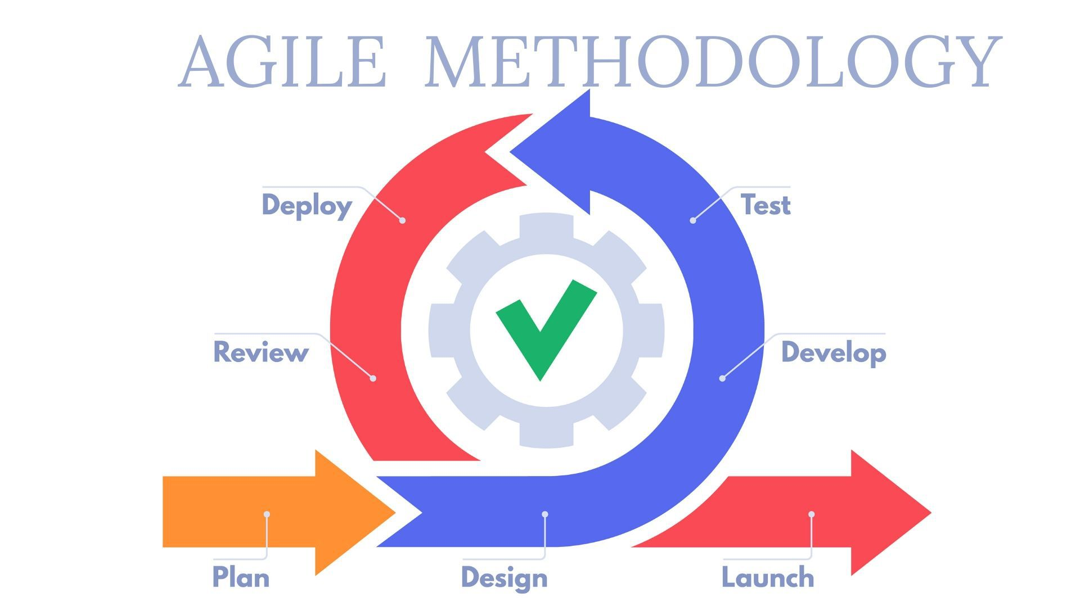
Software Methodologies
Notes:
An iterative approach to software development that helps teams deliver value to their customers faster and with fewer headaches
Instead of betting everything on a "big bang" launch, an agile team delivers work in small, but consumable, increments.

Slide 25
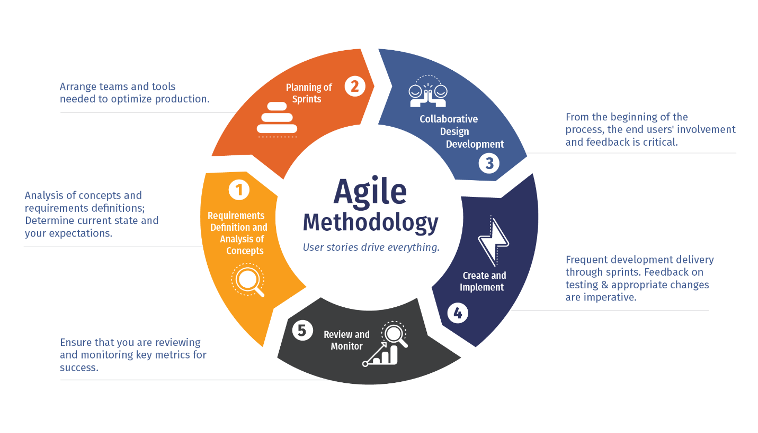
Software Methodologies

Slide 26
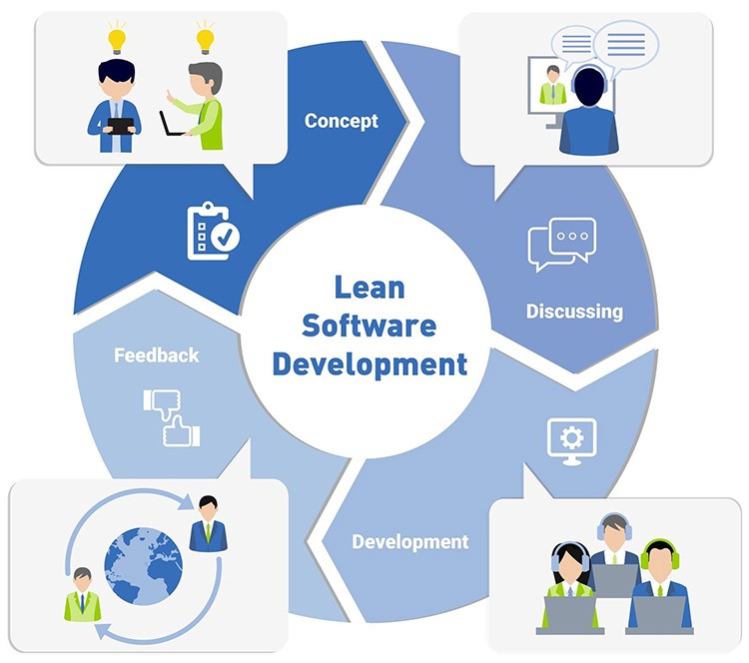
Lean
Software Methodologies
The Lean process is about working only on what must be worked on at the time, so there’s no room for multitasking.
Notes:
In short, Lean methodology is a way of optimizing the people, resources, effort, and energy of your organization toward creating value for the customer.
The Lean process is about working only on what must be worked on at the time, so there’s no room for multitasking.
It is based on two guiding tenets, continuous improvement and respect for people.

Slide 27
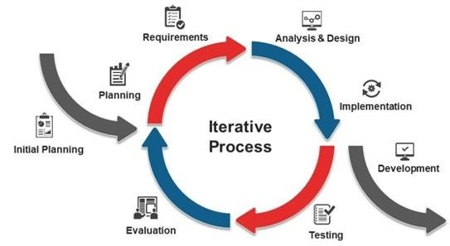
Iterative
Software Methodologies
The Iterative model is repetition incarnate. Instead of starting with fully known requirements, project teams implement a set of software requirements, then test, evaluate and pinpoint further requirements.
A new version of the software is produced with each phase, or iteration. Rinse and repeat until the complete system is ready.

Slide 28
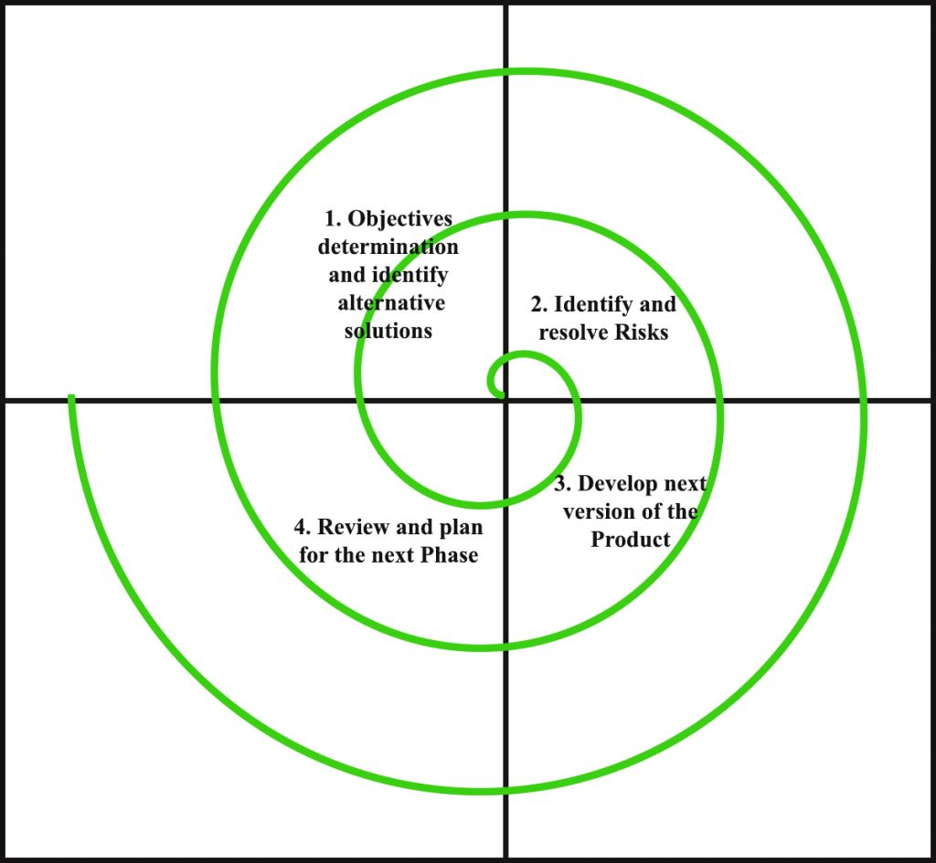
Spiral
Software Methodologies
The project passes through four phases (planning, risk analysis, engineering and evaluation) over and over in a figurative spiral until completed, allowing for multiple rounds of refinement.

Slide 29
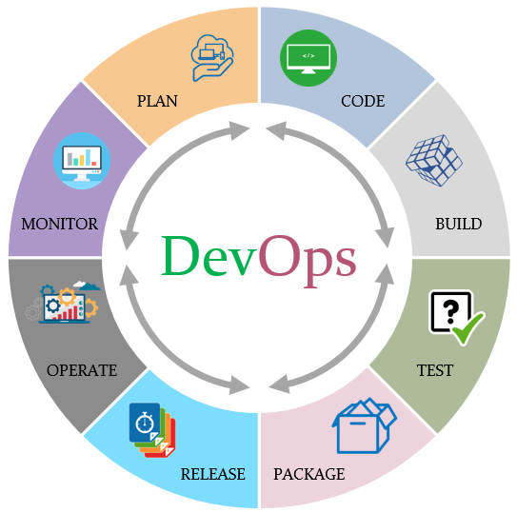
DevOps
Software Methodologies
The DevOps methodology is a relative newcomer to the SDLC scene.
In a DevOps model, Developers and Operations teams work together closely — and sometimes as one team — to accelerate innovation and the deployment of higher-quality and more reliable software products and functionalities.
Notes:
The DevOps methodology is a relative newcomer to the SDLC scene.
It emerged from two trends: the application of Agile and Lean practices to operations work, and the general shift in business toward seeing the value of collaboration between development and operations staff at all stages of the SDLC process.
In a DevOps model, Developers and Operations teams work together closely — and sometimes as one team — to accelerate innovation and the deployment of higher-quality and more reliable software products and functionalities.

Slide 30
04.
The Scrum Framework

Slide 31
What Is The Scrum Framework
The Scrum Framework
It’s an agile, lightweight process.
Can manage and control software and product development.
Uses iterative, incremental practices.
Has a simple implementation.
Increases productivity.
Reduces time to benefits.
Embraces adaptive, empirical systems development.
Embraces the opposite of the waterfall approach…

Slide 32
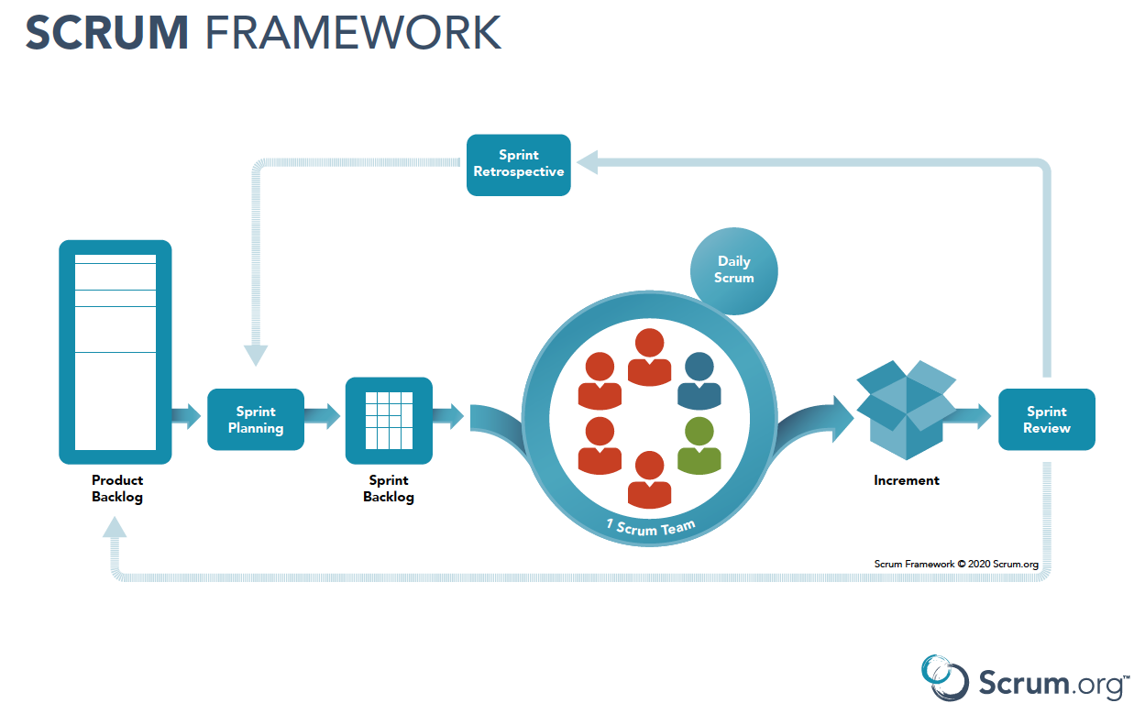
The Scrum Framework

Slide 33

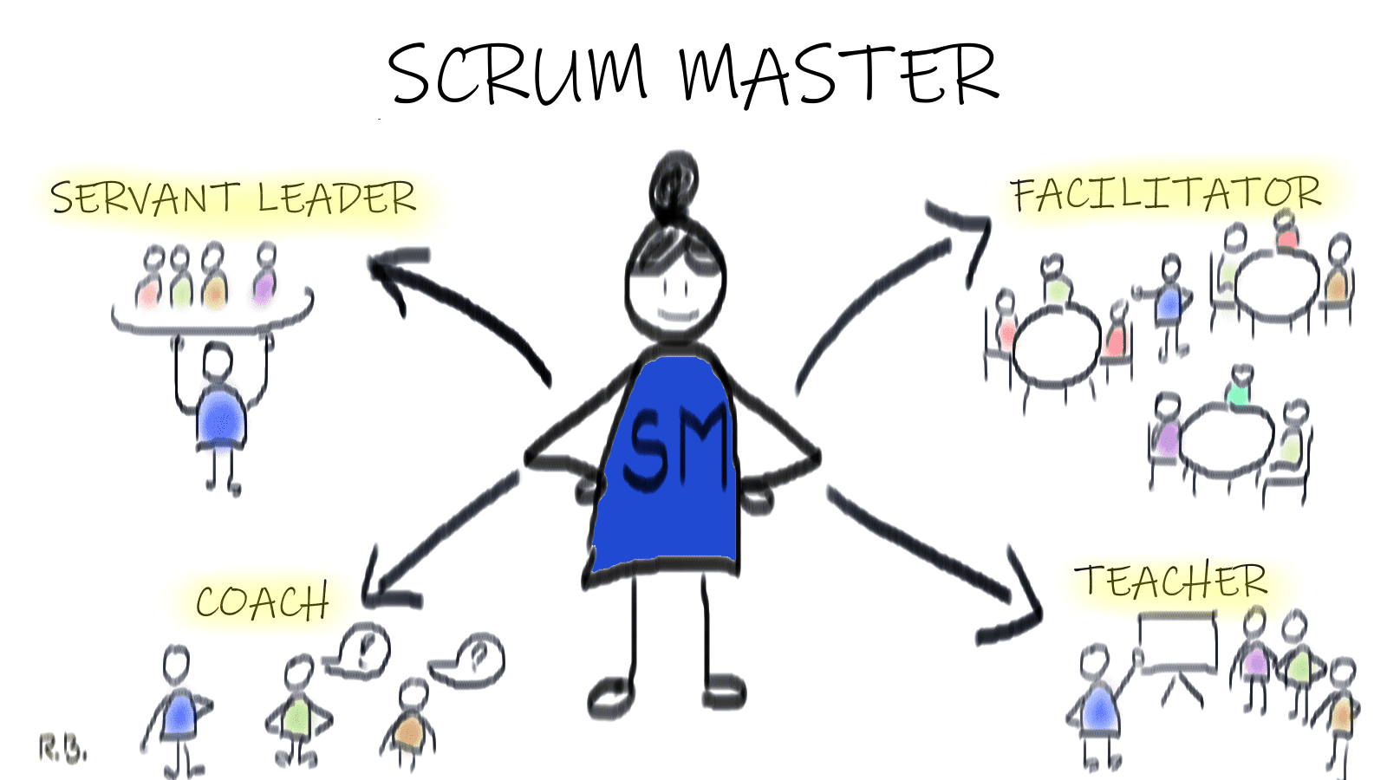
Scrum master
The Scrum Framework
Ensure team coordination and supports project progress

Slide 34
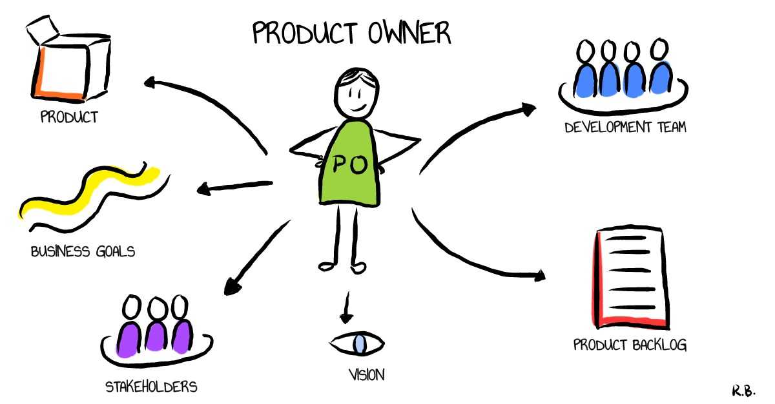
Product Onwer
The Scrum Framework
Represent stakeholders & provide direction

Slide 35
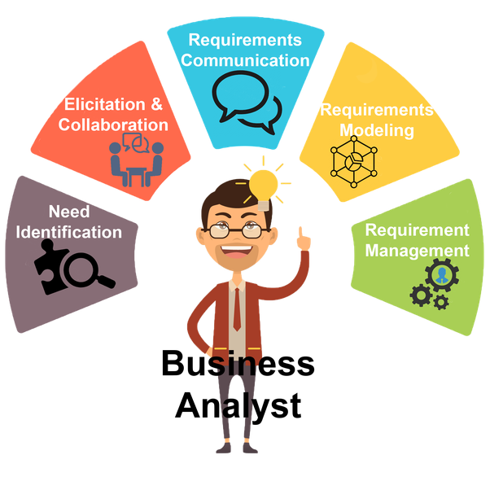
Business Analyst
The Scrum Framework
Works with stakeholders to analyse and document business processes for system to be developed

Slide 36
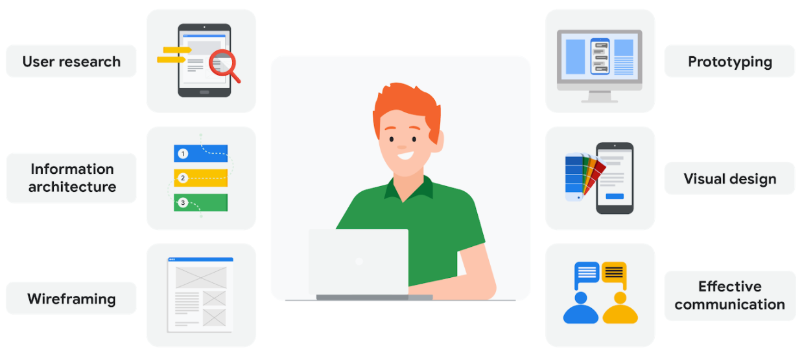
UX Specialist
The Scrum Framework
Ensure best possible user experience

Slide 37
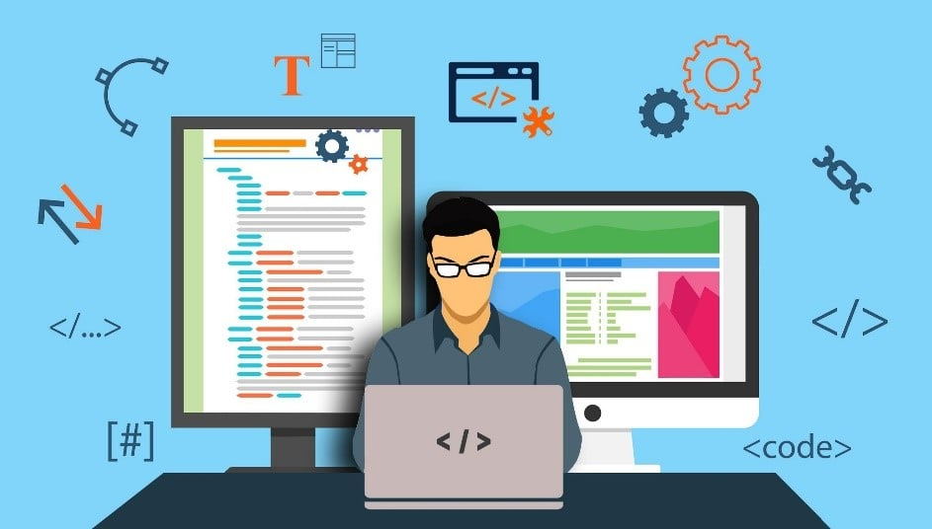
Developers
The Scrum Framework
Individuals who build the required product/features

Slide 38
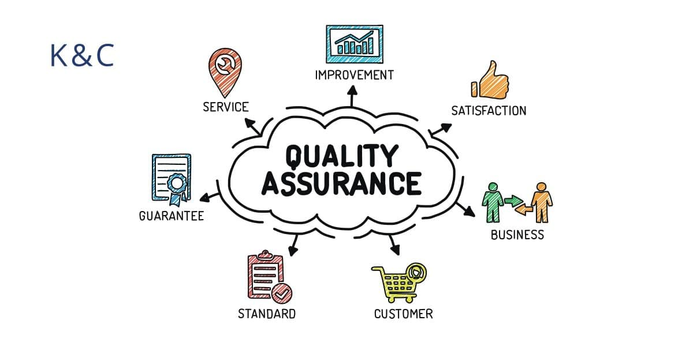
Testers
The Scrum Framework
Responsible for testing the system making sure it works as expected

Slide 39

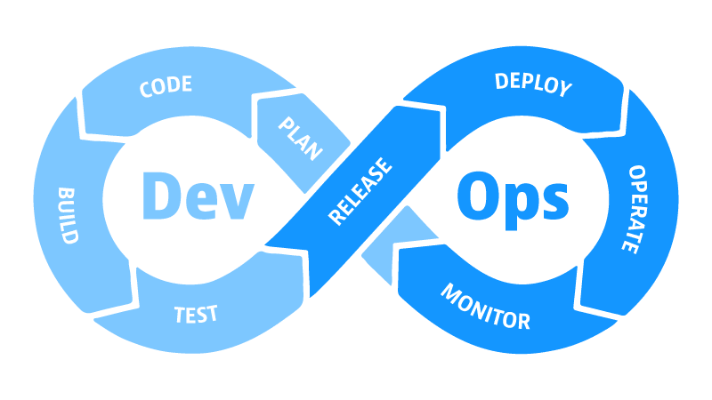
DevOps
The Scrum Framework
Contribute to software maintenance and creation with purpose of making faster updates and writing code that is easy to update and access.

Slide 40
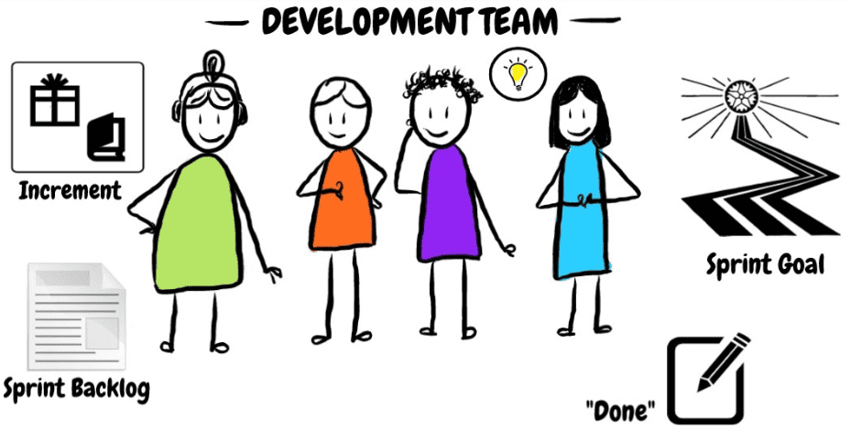
Development team
The Scrum Framework
Notes:
All these roles make up the development team.

Slide 41
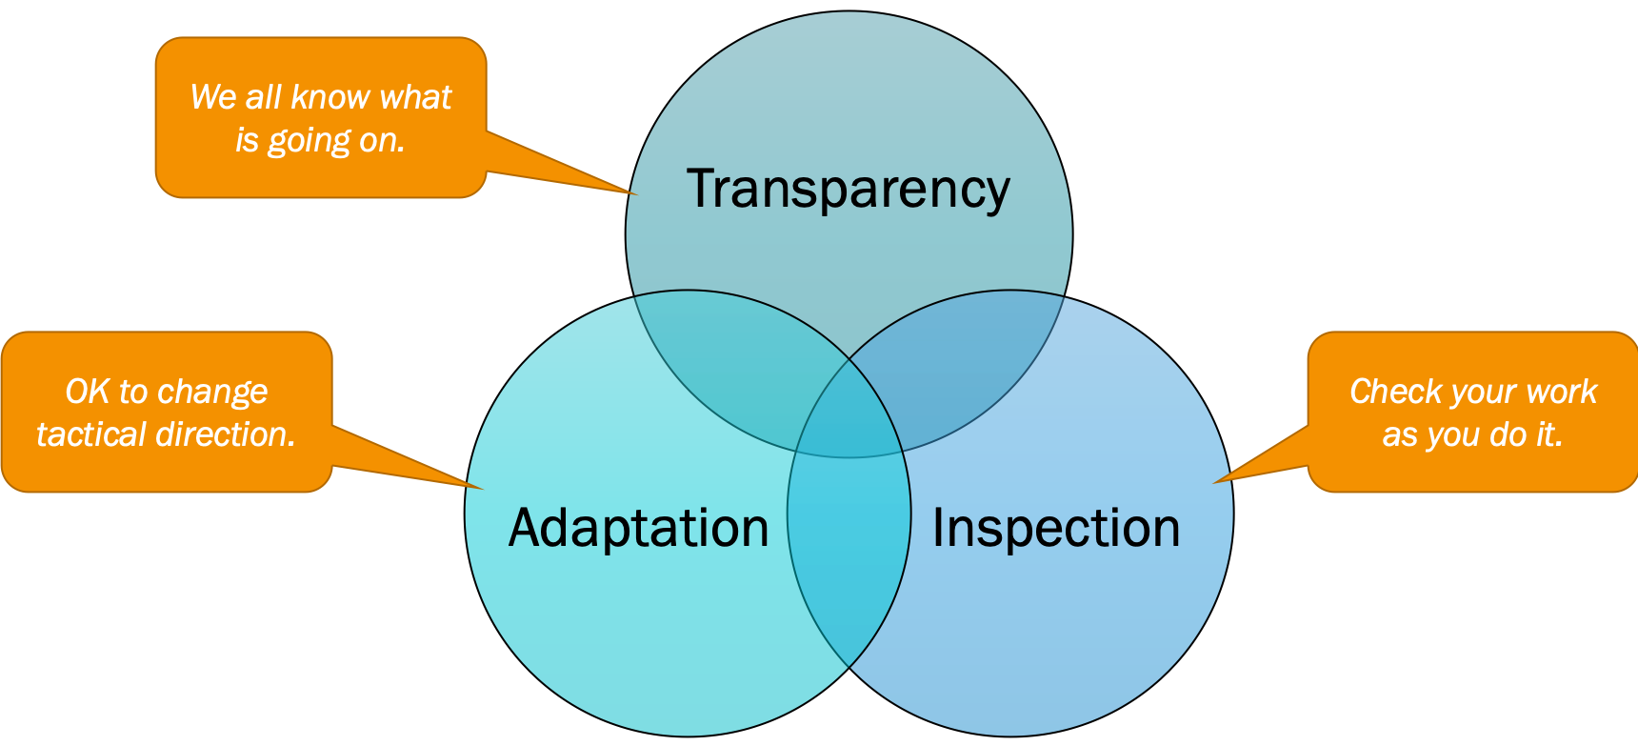
Scrum Three Pillars
The Scrum Framework

Slide 42
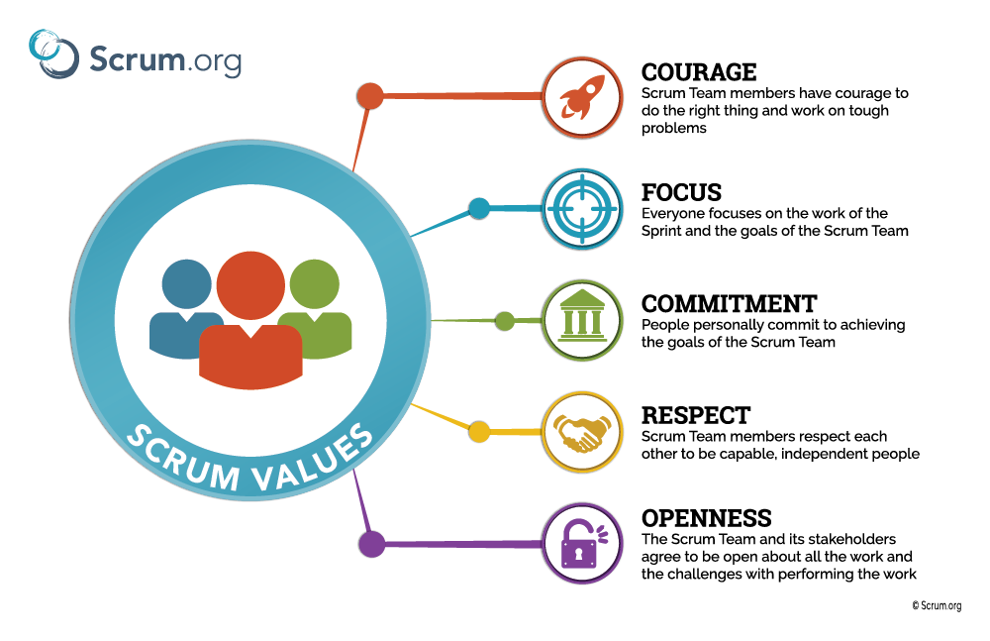
The Scrum Framework
Notes:
-Scrum three pillars

Slide 43

Thanks!
Do you have any questions?
Aviwe.qata@entelect.co.za
+27 834 919 796
Entelect

